Slide 1
Autoencoders

Slide 2
Autoencoders
Autoencoders are a special type of neural network where inputs are outputs are found usually identical. It was designed to primarily solve the problems related to unsupervised learning. Autoencoders are highly trained neural networks that replicate the data. It is the reason why the input and output are generally the same. They are used to achieve tasks like pharma discovery, image processing, and population prediction.
Autoencoders constitute three components namely the encoder, the code, and the decoder. Autoencoders are built in such a structure that they can receive inputs and transform them into various representations. The attempts to copy the original input by reconstructing them is more accurate. They do this by encoding the image or input, reduce the size. If the image is not visible properly they are passed to the neural network for clarification. Then, the clarified image is termed a reconstructed image and this resembles as accurate as of the previous image.

Slide 3
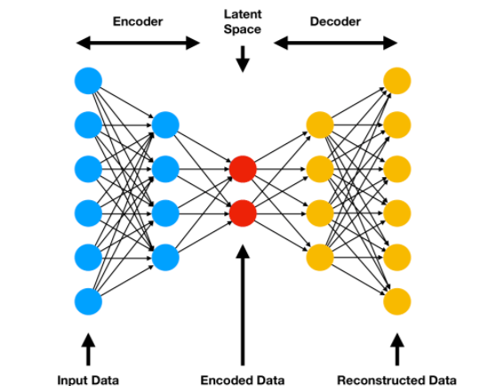
a latent space is defined as an abstract multi-dimensional space that encodes a meaningful internal representation of externally observed events.

Slide 4
Variational Autoencoder (VAE)
Generate Images Using Variational Autoencoder (VAE)
VAE is a generative model that can help to generate fictional data by capturing the characteristics of training data.
This model is built on top of neural networks but is not like CNN or other discriminative models (logistic regression, SVM, etc.) that learn the parameter to find the boundary of classifying different classes, this model learns the parameters in order to model the distribution of the data points.

Slide 5
Traditional autoencoders learn to compress and reconstruct data but not really help with generating new data.
VAE learns the distribution of the data instead of just a compressed image, and by using the distribution, we can decode and generate new data.
The encoder is trying to learn the parameters ϕ to compress data input x to a latent vector z, and the output encoding z is drawn from Gaussian density with parameters ϕ .
As for the decoder, its input is encoding z, the output from the encoder. It parametrizes the reconstructed x’ over parameters θ, and the output x’ is drawn from the distribution of the data.

Slide 6
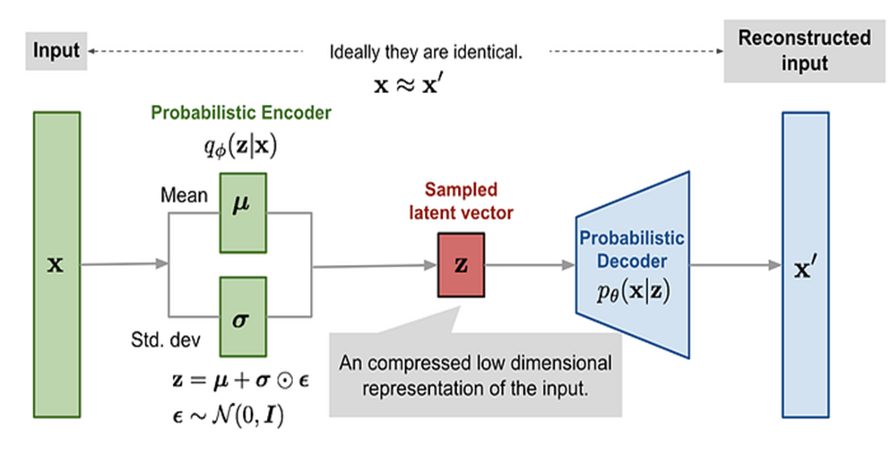

Slide 7
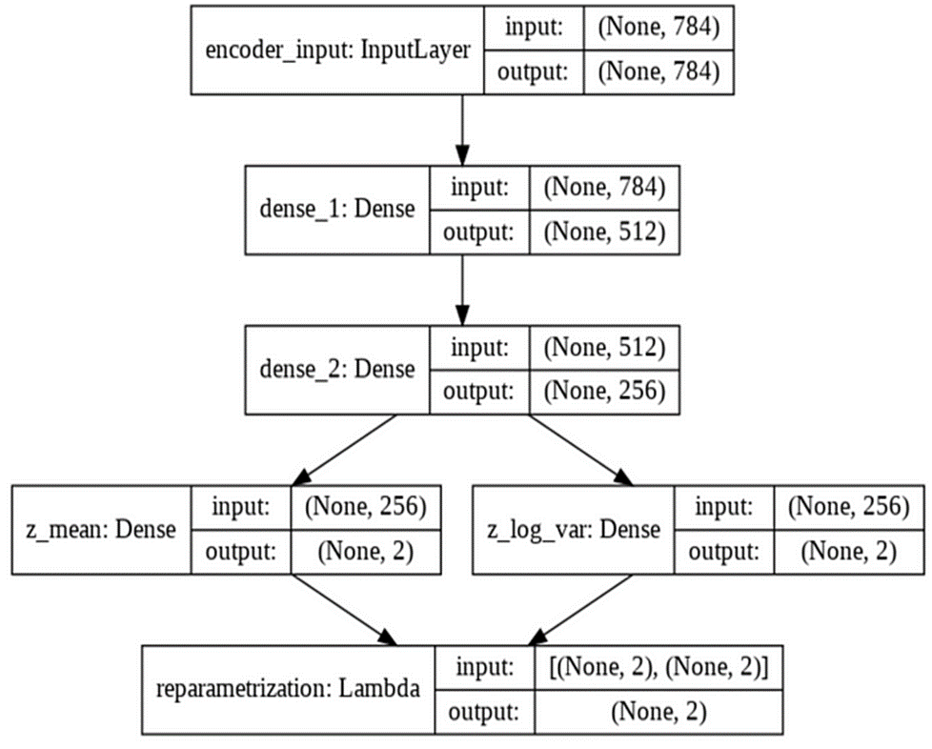
Build Encoder
Encoder’s graph

Slide 8
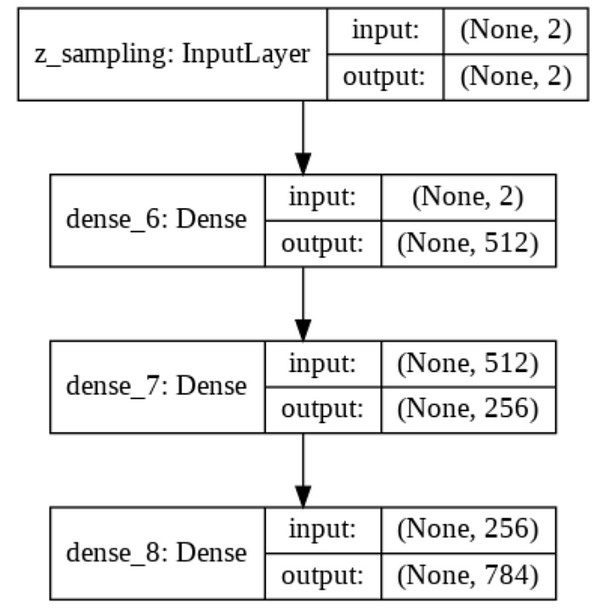
Build Decoder
Decoder’s graph

Slide 9
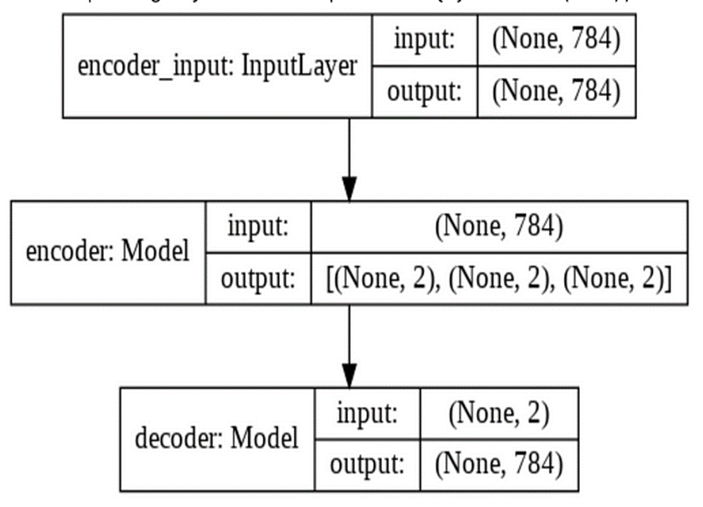
Instantiate VAE
VAE Graph

Slide 10
Loss function
The loss function includes two terms.
The first term is the negative log-likelihood of the decoder which measures that for each data point i, how effectively is the latent vector z reconstructed to x’ and in the code, we use x to approximate x’ and use the built-in binary cross-entropy loss function.
The second term is the KL divergence, which is a regularizer that measures the information loss when we use the encoder q_ϕ to produce z, and in the VAE, p(z) is a standard Gaussian distribution N(0,1).
This is to encourage the encoder to produce z that are close to the gaussian distribution and this means to keep z representations of each different kind of data to be sufficiently diverse and close to each other in the latent space.

Slide 11
Undercomplete Autoencoder
An undercomplete autoencoder is an autoencoder with a compressed hidden layer (bottleneck) that has fewer nodes than the input and output layers.
This structural constraint forces the network to learn a lower-dimensional representation of the input data by capturing only the most essential features, effectively acting as a dimensionality reduction technique without explicit regularization.
It is termed "undercomplete" because it forces the representation to have a lower dimensionality than the input itself, thereby learning to capture only the most essential features.

Slide 12
An undercomplete autoencoder is typically structured into two main components:
Encoder: This part compresses the input into a smaller, dense representation. Mathematically, it transforms the input x using weights W and biases b, and an activation function σ : h=σ(Wx+b). The encoder reduces the dimensionality of the input, preparing a compressed version that retains critical data characteristics.
Decoder: The decoder part aims to reconstruct the original input from the compressed code as accurately as possible. It mirrors the encoder's structure but in reverse, using potentially different weights W′ and biases b′: x̂=σ′(W′h+b′)

Slide 13
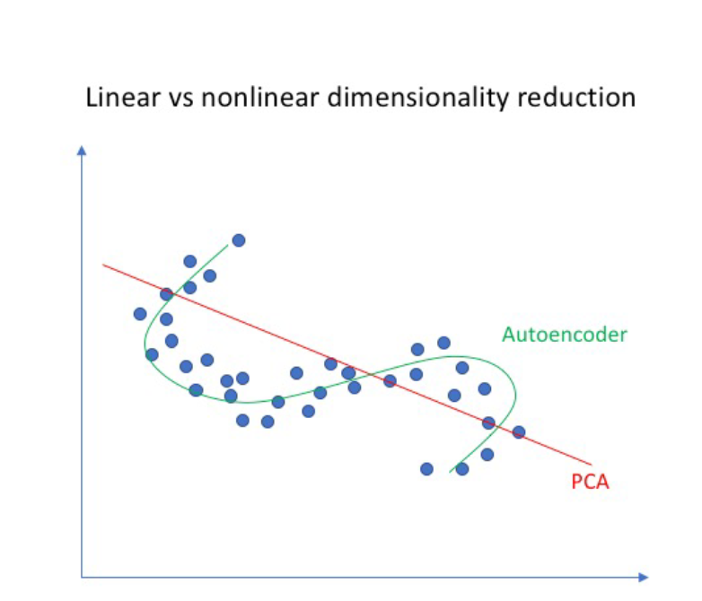
The encoder of a linear autoencoder is equivalent to PCA if we
  use a linear encoder
  use a linear decoder
  use a squared error loss function
  and normalize the inputs

Slide 14
Difference between Vanilla Autoencoders and Undercomplete Autoencoders
Dimensionality Reduction: An undercomplete autoencoder specifically focuses on reducing the dimensionality of the input data, while a vanilla autoencoder does not necessarily do so.
Bottleneck Layer Size: In an undercomplete autoencoder, the bottleneck layer has fewer neurons than the input layer, enforcing a compressed representation. In contrast, a vanilla autoencoder might have a bottleneck layer with an equal or greater number of neurons compared to the input layer.
Generalization: Undercomplete autoencoders, by reducing dimensionality, often capture the most important features of the data, leading to better generalization. Vanilla autoencoders, without a reduced bottleneck, might overfit the data, capturing noise as well as signal.
Example:
Vanilla Autoencoder: Input size = 784, Hidden layer 1 size = 128, Bottleneck size = 64, Output size = 784.
Undercomplete Autoencoder: Input size = 784, Hidden layer 1 size = 128, Bottleneck size = 32, Output size = 784.
In the undercomplete version, the bottleneck size (32) is significantly smaller than the input size (784), forcing the network to learn a compressed representation of the data.

Slide 15

Regularized Autoencoders
While poor generalization could happen even in undercomplete autoencoders it is an even more serious problem for overcomplete auto encoders
Here, (as stated earlier) the model can simply learn to copy x_{i} to h and then h to x̂_{i}
To avoid poor generalization, we need to introduce regularization
The simplest solution is to add a L2-regularization term to the objective function

Slide 16
Another trick is to tie the weights of the encoder and decoder
i.e., W ∗ =W^{T}
This effectively reduces the capacity of Autoencoder and acts as a regularizer

Slide 17

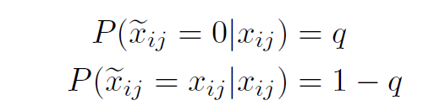
Denoising auto encoders
A denoising encoder simply corrupts the input data using a probabilistic process before feeding it to the network
A simple used in practice is the following
In other words, with probability q the input is flipped to 0 and with probability (1-q) it is retained as it is.

Slide 18
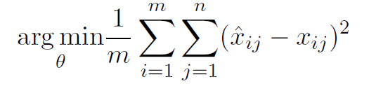


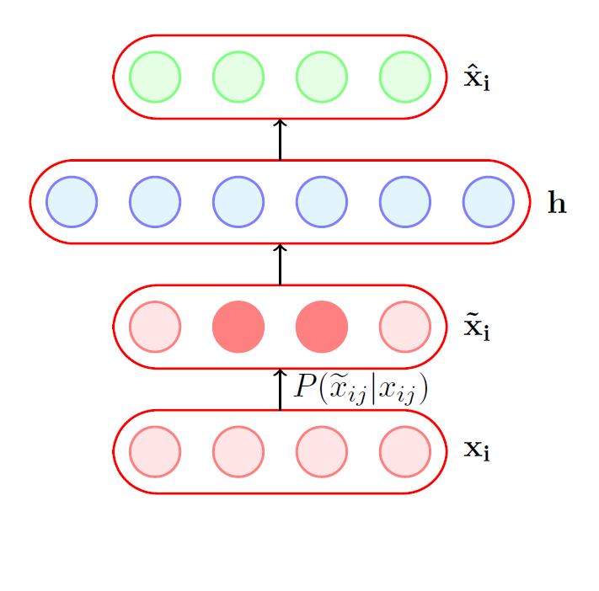
This helps because the objective is still to reconstruct the original (un-corrupted) x_{i}
It no longer makes sense for the model to copy the corrupted into and then into x̂_{i} (the objective function will not be minimized by doing so)
Instead, the model will now have to capture the characteristics of the data correctly.
For example, it will have to learn to
reconstruct a corrupted x_{ij} correctly by relying on its interactions with other elements of x_{i}

